Slide 1
Generative networks
Kevin Li
Gatsby MLJC
09/10/2016

Slide 2
Stochastic Generative Network
Autoencoder (AE)
Denoising autoencoder (DAE), Vincent 2008
DAE as generative model, Bengio 2013
Deep GSN, Bengio 2014

Slide 3
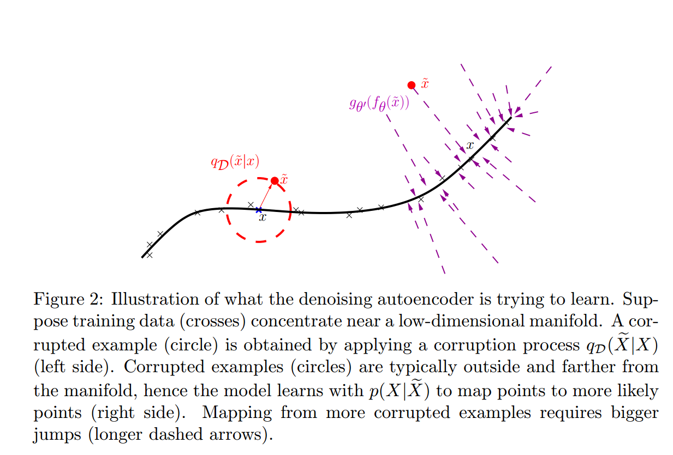
Denoising autoencoder

Slide 4
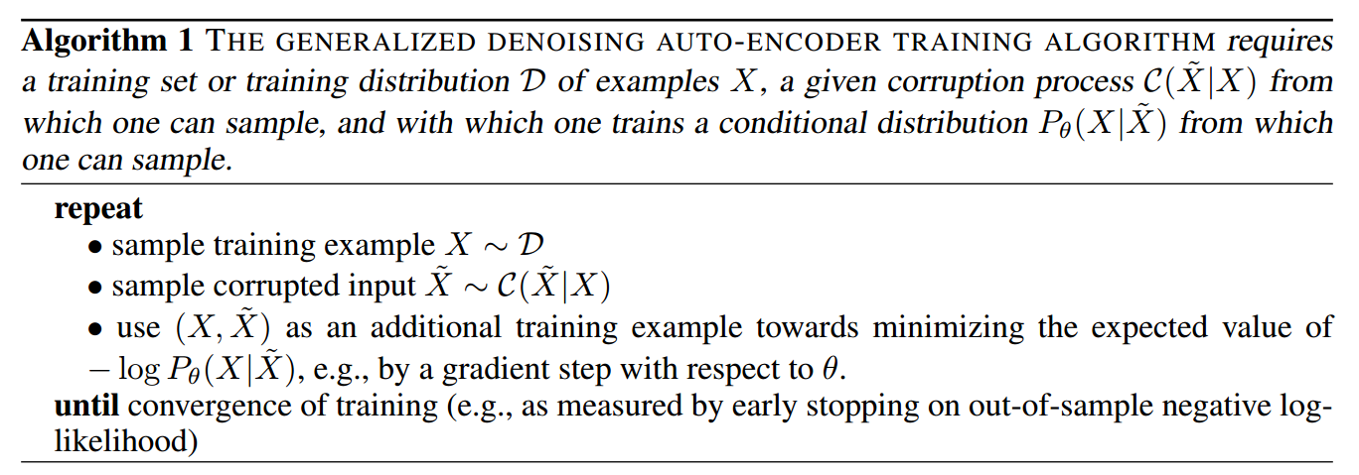
DAE as generative model

Slide 5
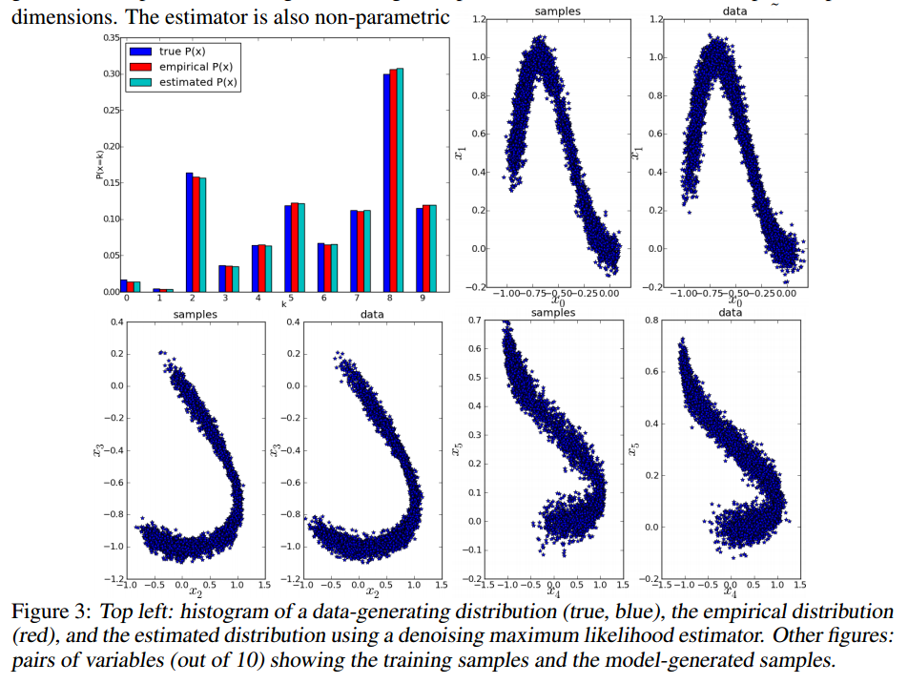
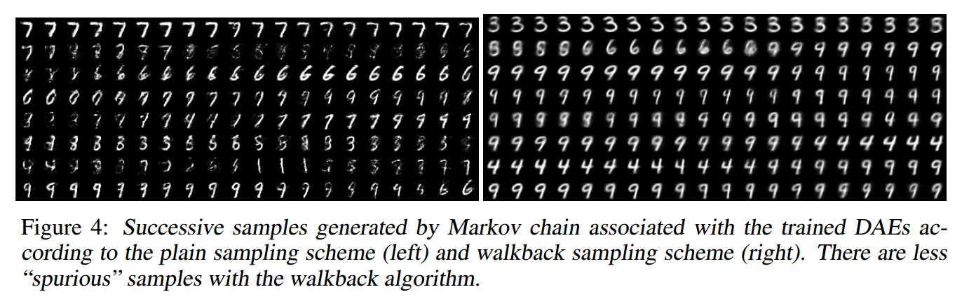
DAE as generative model

Slide 6
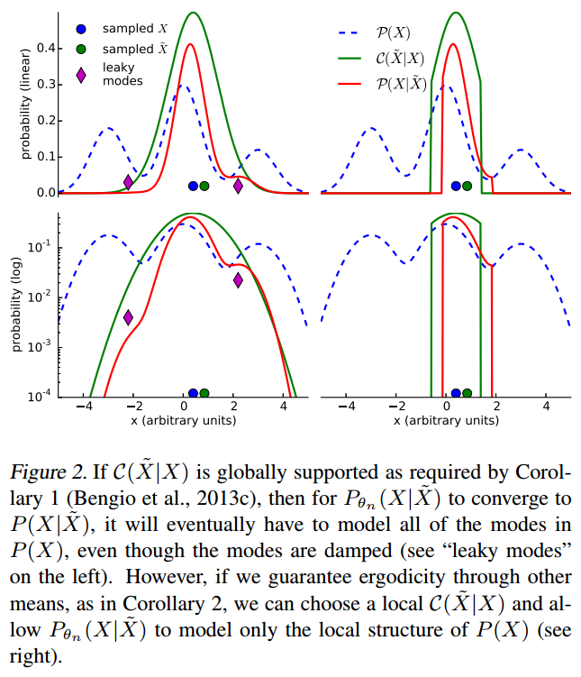
DAE as generative network

Slide 7
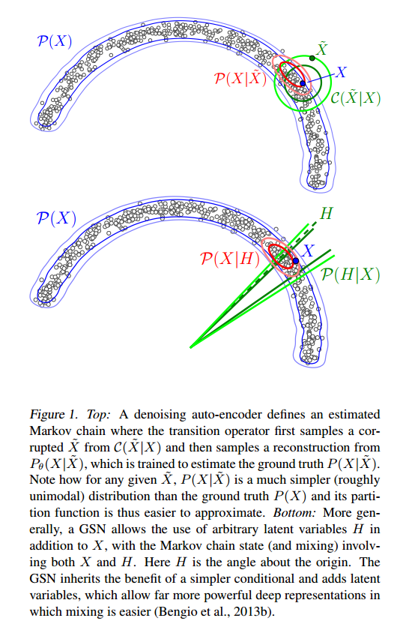
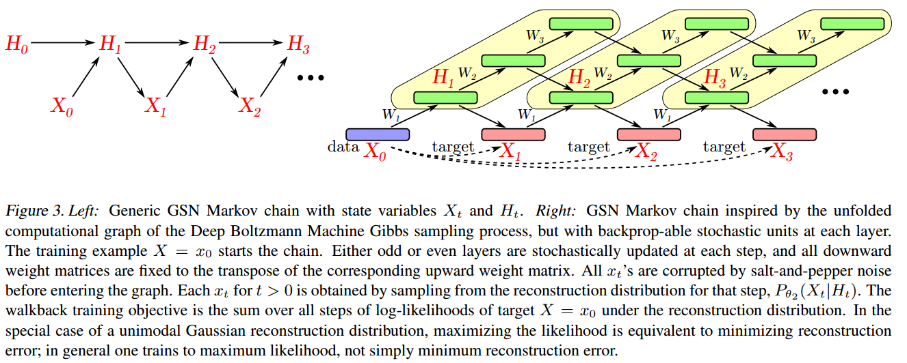
Deep Stochastic Networks

Slide 8
Generative Adversarial Network
Original paper: Goodfellow et al, 2014
Hierachical GAN: Denton and Facebook AI, 2015
Representation learning: Indico Research andFacebook AI
InfoGAN: OpenAI

Slide 9
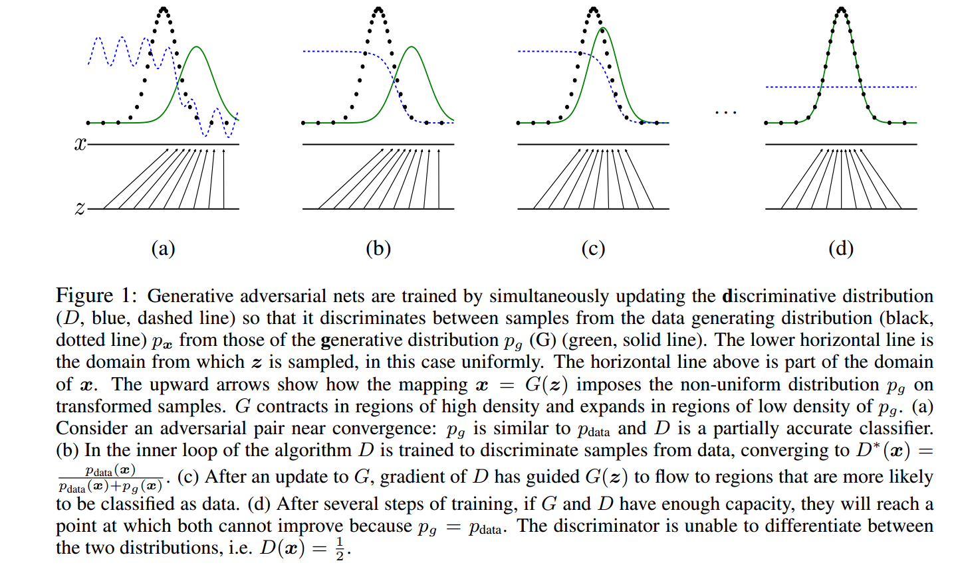
GAN: basic concept

Slide 10
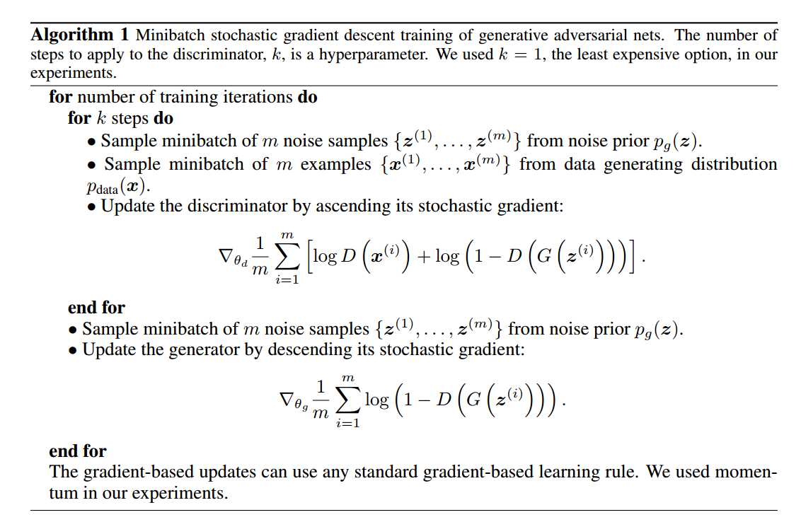
GAN: algorithm

Slide 11
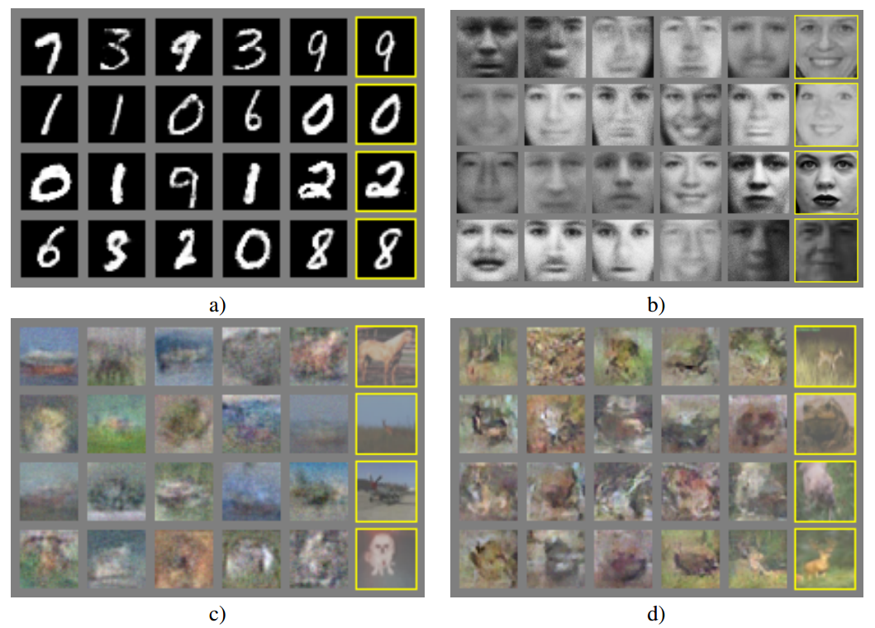
Experiments

Slide 12
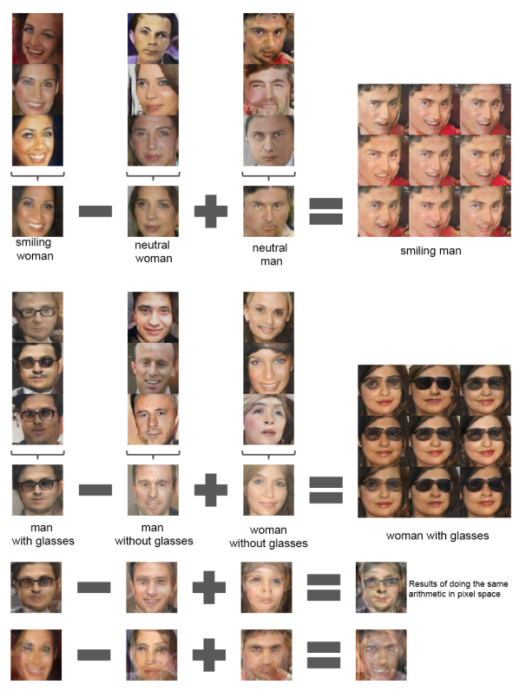
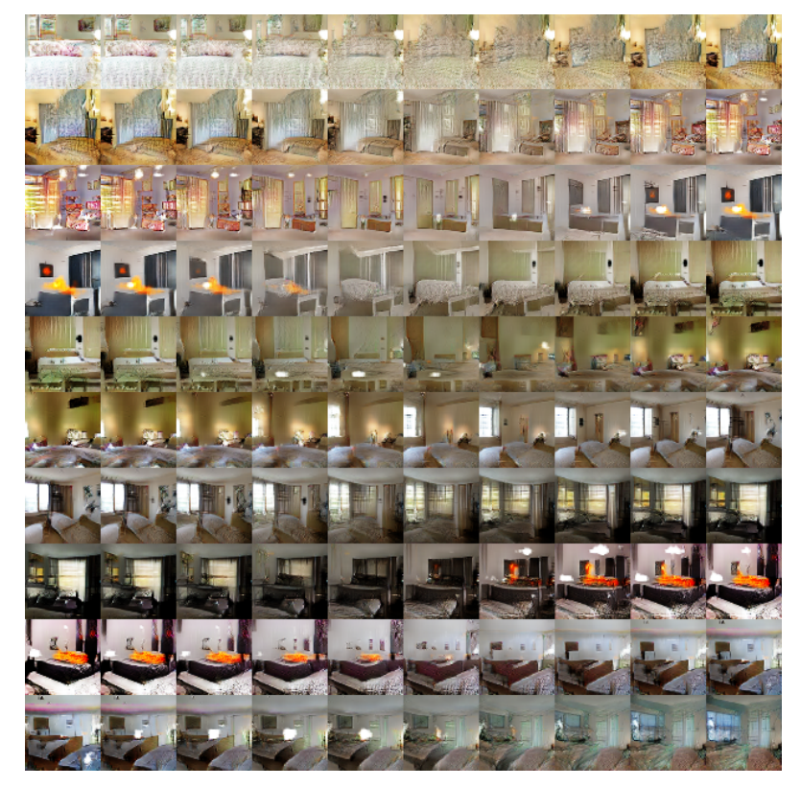
Visualisation of representation in Z

Slide 13
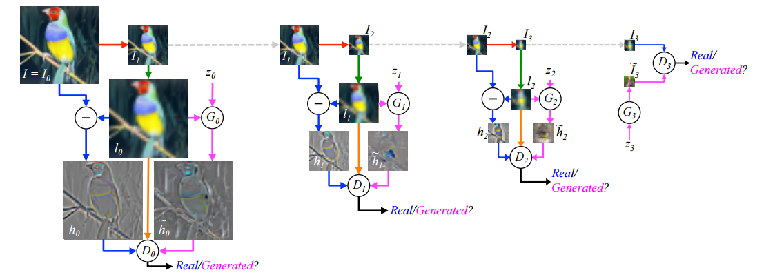
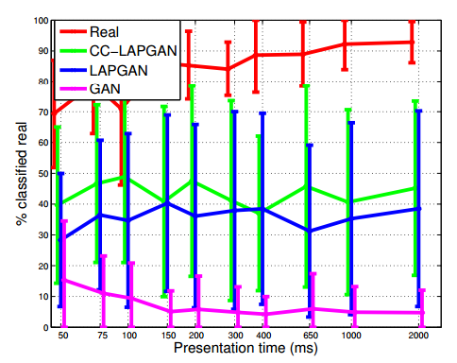
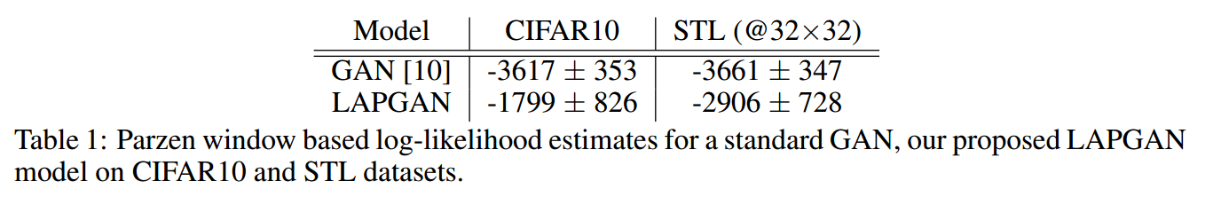
Pyramid

Slide 14
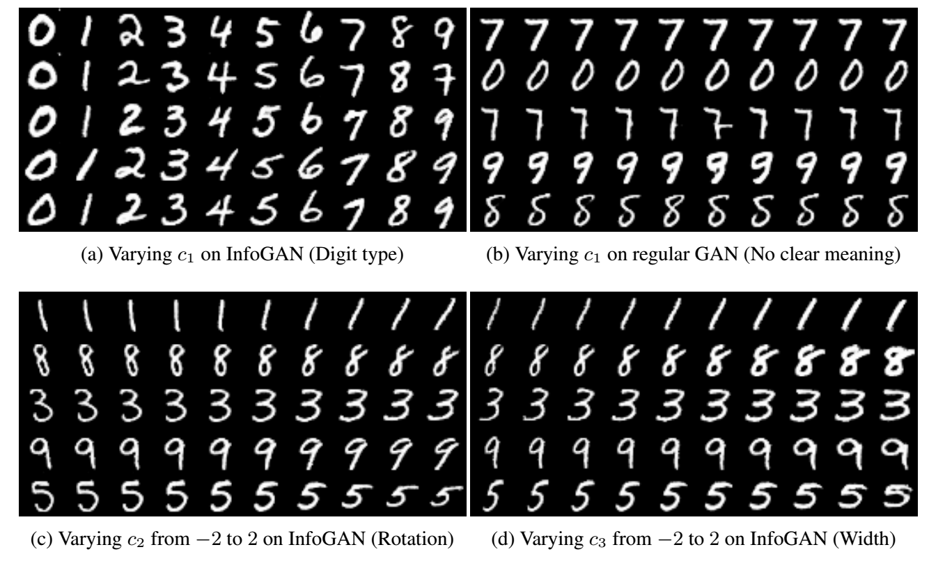
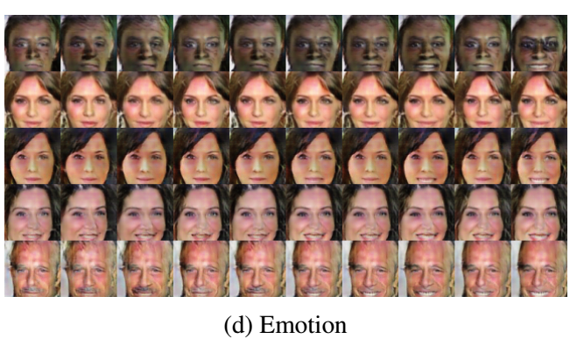
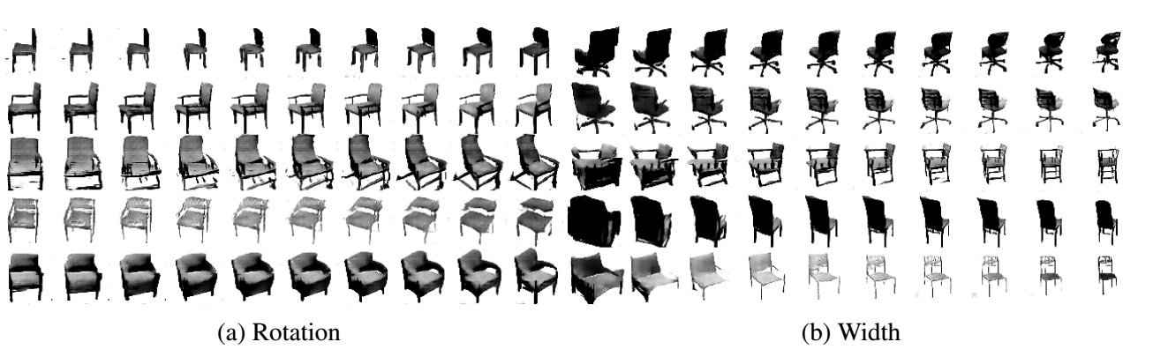
InfoGan

